Slide 1

Internet Programming For Web App Development- CSA4305
Title
DYNAMIC ONLINE JOB PORTAL AND RECRUITMENT MANAGEMENT SYSTEM
PRESENTING BY:
S.SHASHI VARDHAN(192311155)
P.PRAVEEN(192372105)
G.NAVEEN(192324110)
N.LOKABANDHAVA(192324169)
Under the Supervision of:
DR.D.SUDHAGAR
Notes:
1
1

Slide 2
Introduction
Job Portal Web Application is an online platform that connects job seekers and employers in a centralized system.
It enables users to register, create profiles, search for jobs, and apply for suitable positions.
Employers can post job vacancies, manage applications, and track recruitment activities efficiently.
The system provides secure authentication, application tracking, and administrative monitoring to streamline the hiring process.

Slide 3
Problem Statement
Traditional recruitment methods are often manual, time-consuming, and inefficient for both job seekers and employers.
Job seekers face difficulties in finding suitable job opportunities and tracking their application status.
Employers struggle to manage multiple job postings and handle a large number of applications effectively.
Therefore, a centralized web-based Job Portal is required to streamline recruitment, improve communication, and simplify the hiring process.

Slide 4
LITERATURE REVIEW
S. No. | Year | Author(s) | Title of the Paper | Key Findings
1 | 2023 | Rajesh Kumar & Anjali Sharma | Ahmed Hassan & Sarah Williams | Developed an online recruitment platform that simplified job posting, candidate registration, and application tracking for employers and job seekers.
2 | 2024 | John Smith & Michael Brown | Online Recruitment System Using Web Technologies | Proposed a web-based recruitment system that improved hiring efficiency, reduced manual effort, and enhanced communication between employers and candidates.
3 | 2024 | Priya Verma et al. | Design and Development of a Job Recruitment Portal | Implemented a centralized job portal with secure authentication, resume management, and application tracking features.
4 | 2025 | Ahmed Hassan & Sarah Williams | Modern E-Recruitment Platforms: A Systematic Review | Reviewed digital recruitment platforms and concluded that online job portals improve accessibility, hiring speed, and candidate engagement.

Slide 5
Objectives
To develop a secure and user-friendly web-based Job Portal for connecting job seekers and employers.
To enable employers to post, manage, and track job vacancies efficiently.
To allow job seekers to search, apply, and track job applications online.
To automate the recruitment process and improve overall hiring efficiency.

Slide 6
Existing System vs Proposed System
The existing recruitment process relies on manual methods such as newspapers, consultancies, and disconnected job portals, making job searching and hiring inefficient.
Candidates often face difficulties in finding suitable jobs and tracking their application status, while employers struggle to manage large volumes of applications.
The proposed Job Portal Web Application provides a centralized platform where employers can post jobs and candidates can search and apply online.
The system automates recruitment activities, offers real-time application tracking, and improves overall efficiency, accessibility, and user experience.

Slide 7
MODULES
Module 1: User Authentication & Profile Management
Module 2: Employer Dashboard & Job Management
Module 3: Job Search & Application System
Module 4: Admin Panel & Reports

Slide 8
Module 1: User Authentication & Profile Management
Enables users to register and create an account using personal details.
Provides secure login and logout functionality with authentication mechanisms.
Allows users to create, update, and manage their profiles and upload resumes.
Ensures data security through session management and password protection.

Slide 9
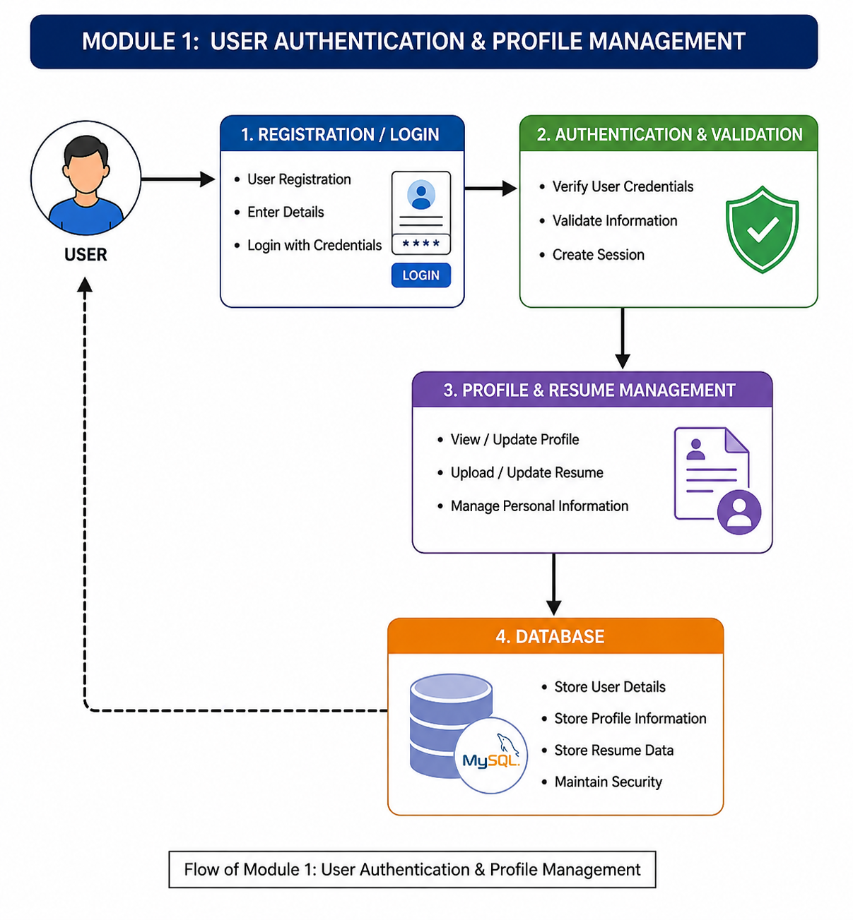

Slide 10
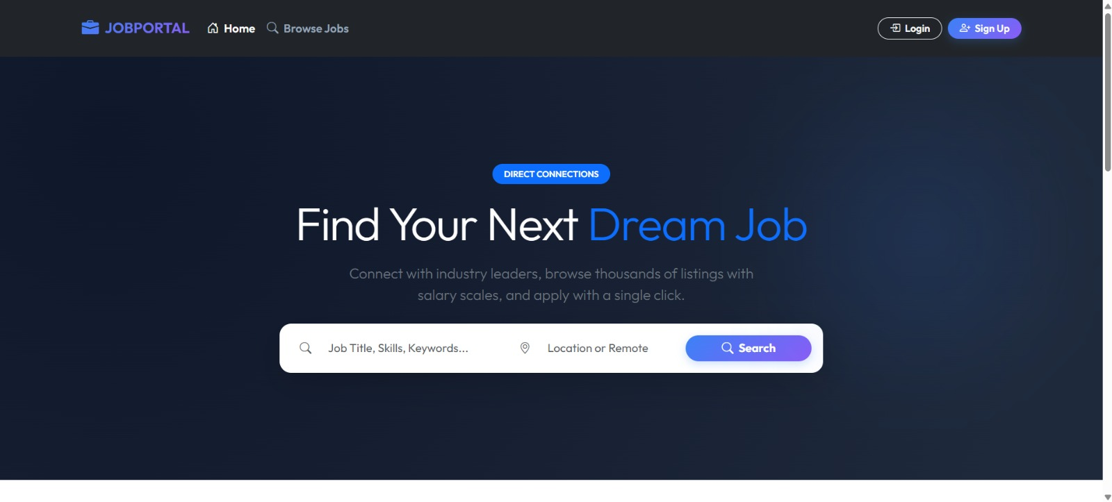

Slide 11
Module 2: Employer Dashboard & Job Management
Enables employers to register and manage their company profiles.
Allows employers to create, update, and delete job postings.
Provides facilities to view and manage job applications.
Helps employers track recruitment activities efficiently.

Slide 12
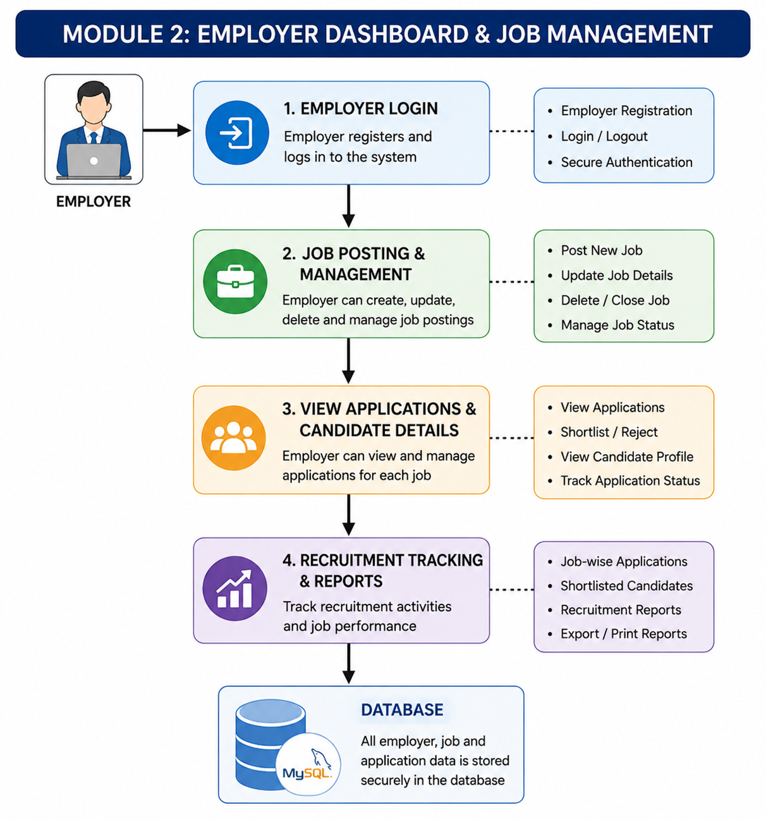

Slide 13
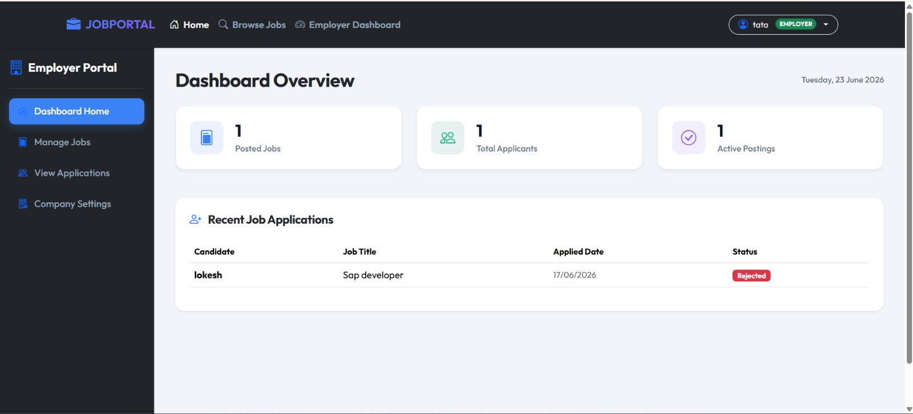

Slide 14
Module 3: Job Search & Application System
This module allows job seekers to search for job opportunities using keywords, categories, skills, and location-based filters.
Users can view detailed job descriptions, eligibility criteria, salary information, and company details before applying.
Candidates can apply for jobs online by uploading their resumes and submitting application forms through the portal.

Slide 15
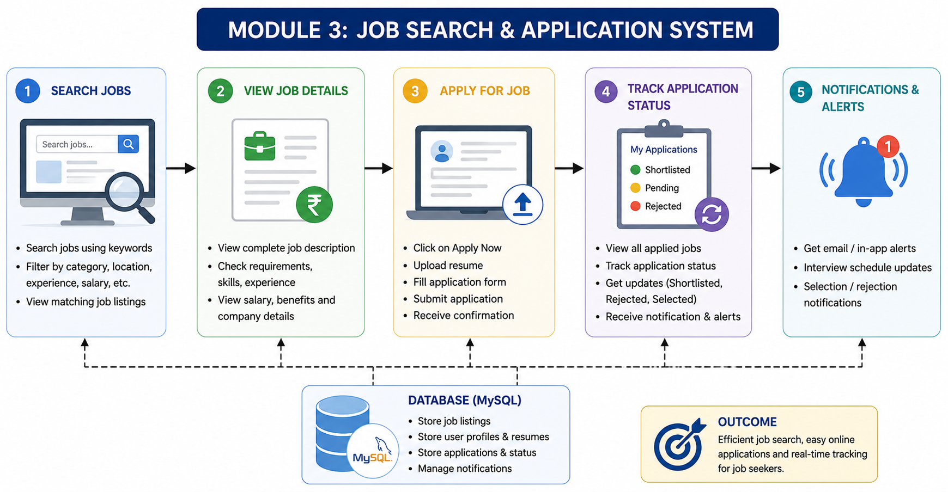

Slide 16
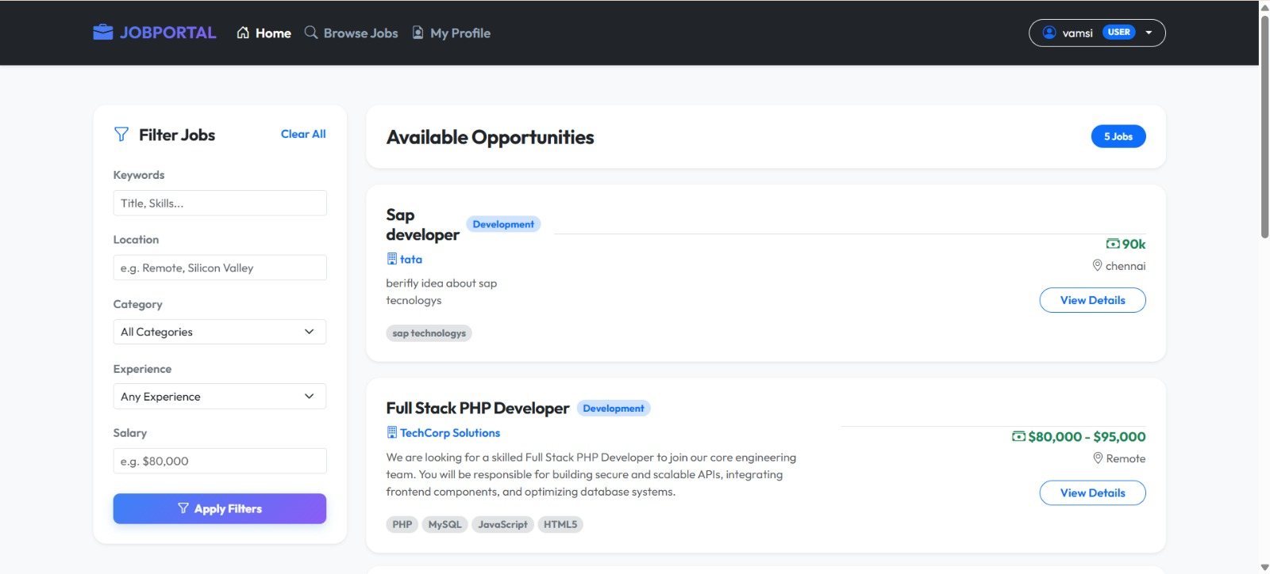

Slide 17
Module 4: Admin Panel & Reports
Enables the administrator to manage users, employers, and job postings from a centralized dashboard.
Monitors system activities, user registrations, and job application statistics.
Generates reports related to jobs, applications, and platform usage.
Ensures data security, system maintenance, and overall platform management.

Slide 18
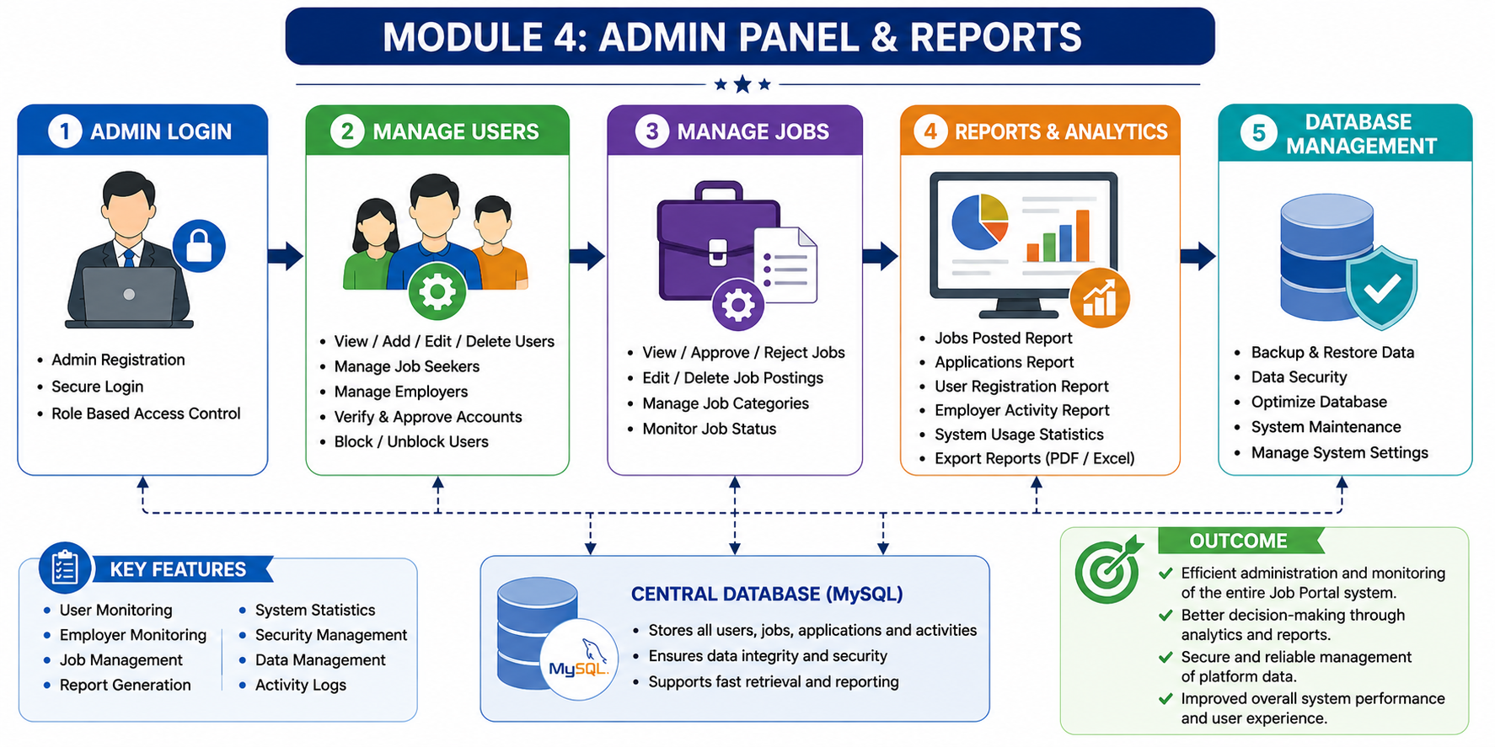

Slide 19
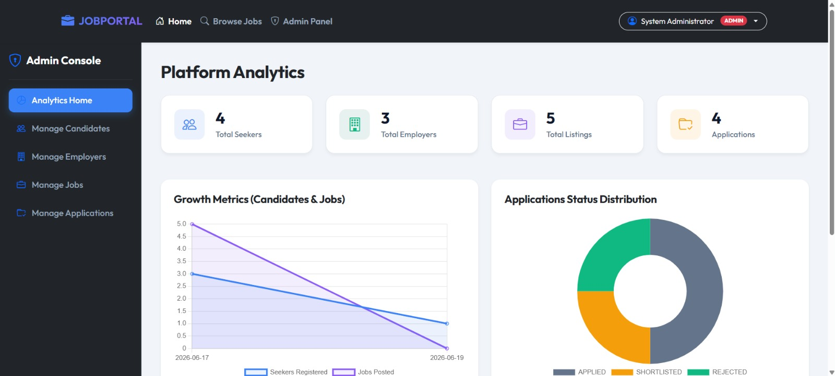

Slide 20
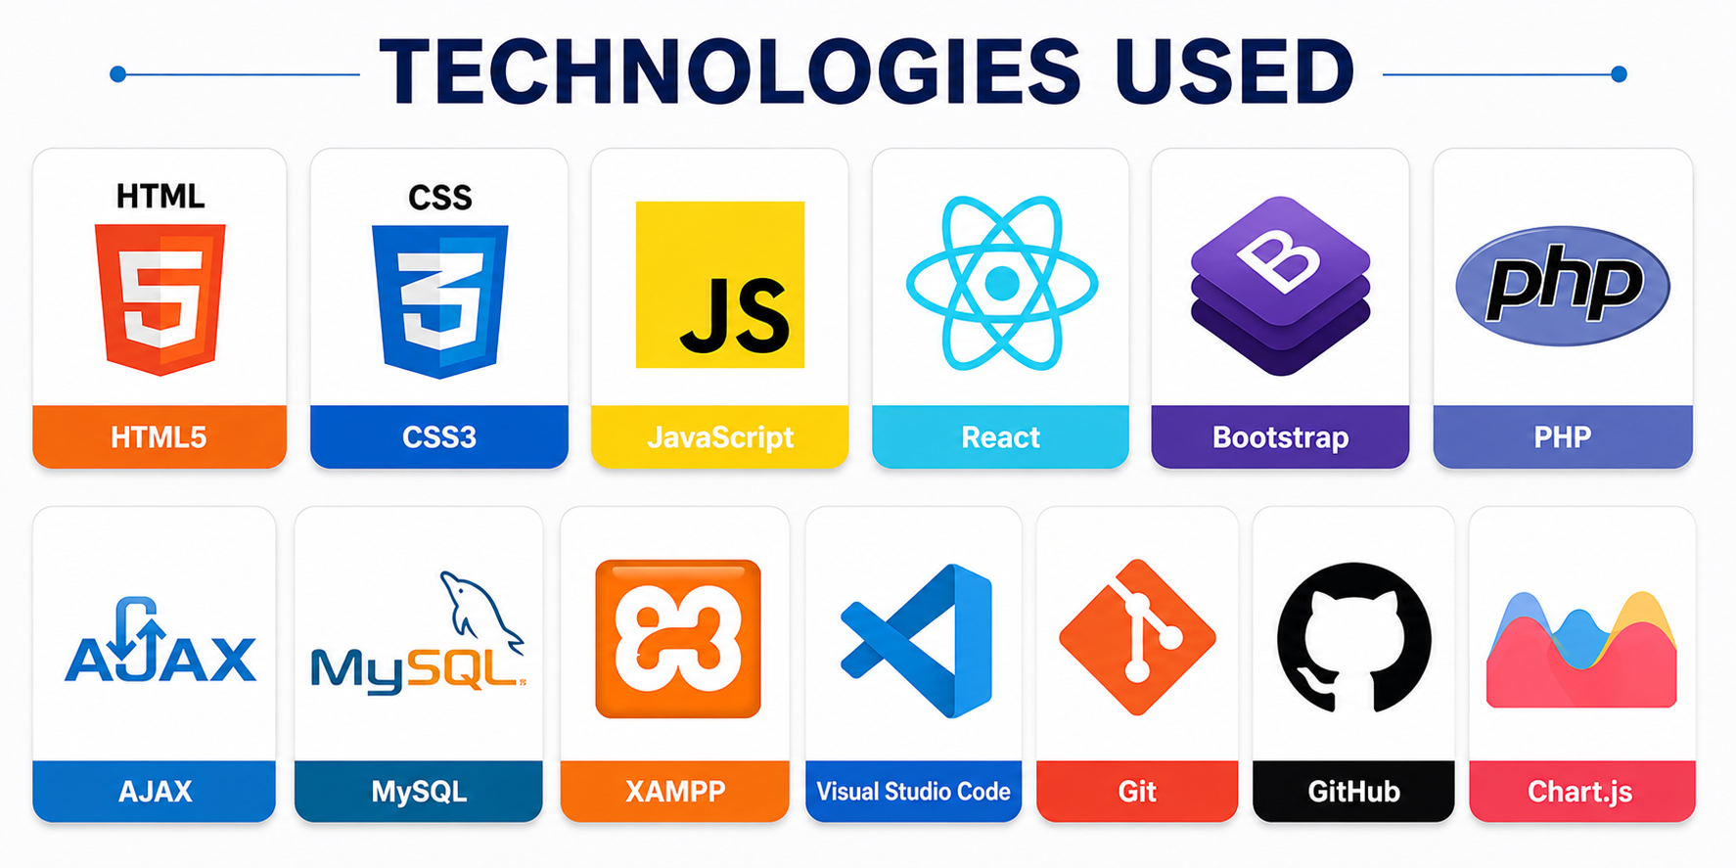
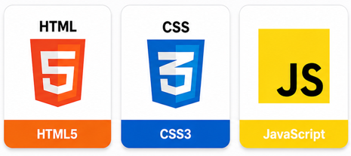

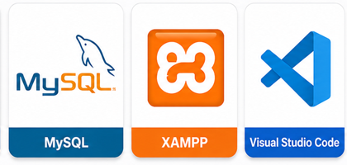

Slide 21
Conclusion
The Job Portal Web Application provides a centralized platform that connects job seekers and employers efficiently.
It simplifies the recruitment process through online job posting, job searching, and application tracking features.
The system ensures secure user management, efficient data handling, and improved communication between employers and candidates.
Overall, the project enhances recruitment efficiency, reduces manual effort, and offers a user-friendly solution for modern hiring needs.

Slide 22
References
Silberschatz, A., Korth, H. F., & Sudarshan, S. (2019). Database System Concepts (7th ed.). McGraw-Hill Education.
Freeman, E., Robson, E., Sierra, K., & Bates, B. (2021). Head First HTML and CSS (2nd ed.). O'Reilly Media.
Nixon, R. (2021). Learning PHP, MySQL & JavaScript (6th ed.). O'Reilly Media.
Duckett, J. (2014). JavaScript and jQuery: Interactive Front-End Web Development. Wiley.
Bootstrap Team. (2025). Bootstrap Documentation. Retrieved from https://getbootstrap.com
PHP Documentation Group. (2025). PHP Manual. Retrieved from https://www.php.net/docs.php
Oracle Corporation. (2025). MySQL Documentation. Retrieved from https://dev.mysql.com/doc

Slide 23


